Slide 1
UPPER SIXTH ARTS
GEOGRAPHY
Lesson 14
Spatial Interaction
Notes:
Good morning, class, and welcome to our geography lesson. I am your geography teacher, Mr Kamdem. Today we are starting Lesson 14: Spatial Interaction.

Slide 2
CLASS INFO
Class, Chapter and Duration
Class | Upper Sixth Arts
Chapter | Module 4: Understanding and managing population dynamics across the world in general and Cameroon in particular
Duration | 2 periods (2 × 50 minutes)
Notes:
This lesson is for Upper Sixth Arts. It belongs to Module 4: Understanding and managing population dynamics across the world in general and Cameroon in particular. We shall need 2 periods to cover it.

Slide 3
IDENTIFICATION
Lesson Identification
Topic | Population Change over Space (Migration)
Sub-topic | Migration Laws
Lesson | Lesson 14: Spatial Interaction
Notions / Concepts | Spatial interaction, network, complementarity, transferability, intervening opportunity, distance decay, Ullman.
Syllabus focus | Meaning of spatial interaction (tangible and intangible flows, networks, measurement); Ullman's factors: complementarity, transferability, intervening opportunity, distance decay.
Competence | Learners are able to explain the flows of people, goods and information between places using the factors of spatial interaction.
Notes:
Our topic is Population Change over Space (Migration), and the sub-topic is Migration Laws. The key notions we shall use today are: spatial interaction, network, complementarity, transferability, intervening opportunity, distance decay, Ullman. At the end, you should be able to do this: learners are able to explain the flows of people, goods and information between places using the factors of spatial interaction.

Slide 4

HOMEWORK CORRECTION
Correction of the Homework
Question (Lesson 13: Migration: Characteristics, Laws and Models):
Define spatial interaction.
Notes:
Before we start the new lesson, let us correct the homework I gave you at the end of Lesson 13: Migration: Characteristics, Laws and Models. The question was: Define spatial interaction. Take out your exercise books.

Slide 5
HOMEWORK CORRECTION
Correction: Possible Answer
Spatial interaction is the movement of people, goods, services and information between places.
Notes:
Here is a good answer. Spatial interaction is the movement of people, goods, services and information between places. Compare it with your own answer and correct your work in red.

Slide 6
LESSON PLAN
Lesson Plan
Correction of the homework
Objectives and recall
Real-life situation and action to take
Learning activities
Board summary
Evaluation, remediation and homework
Notes:
Here is the plan of our lesson today. First, we shall correct the homework. Then we shall look at the objectives and recall what you already know. After that, we shall study a situation from real life and the action to take, and do the learning activities. Finally, we shall copy the board summary, do the evaluation and the remediation, and I will give you the homework.

Slide 7
OBJECTIVES
Objectives
By the end of this lesson, you should be able to:
Define spatial interaction.
Distinguish tangible and intangible flows.
Explain complementarity and transferability.
Notes:
Take your time to copy this part; we will continue together.

Slide 8
OBJECTIVES
Objectives (continued)
Explain intervening opportunity and distance decay.
Notes:
By the end of this lesson, you should be able to do four things. Number 1: define spatial interaction. Number 2: distinguish tangible and intangible flows. Number 3: explain complementarity and transferability. Number 4: explain intervening opportunity and distance decay.

Slide 9
PREVIOUS KNOWLEDGE
Previous Knowledge
Migration decreases with distance.
Big towns attract more people.
The gravity model uses population and distance.
Notes:
Let us first remember what you already know. Migration decreases with distance. Big towns attract more people. The gravity model uses population and distance. Keep this in mind, because we shall build on it today.

Slide 10
REAL-LIFE SITUATION
Situation in Real Life
Aïssatou sells fresh tomatoes at the Central Market of Garoua.
Every few days she travels to buy new stock.
Notes:
Take your time to copy this part; we will continue together.

Slide 11
REAL-LIFE SITUATION
Situation in Real Life (continued)
She knows that there are big tomato farms near Maroua, but she almost always goes to Pitoa, which is closer: the trip is faster and cheaper, and she can be back at her stall the same day.
Notes:
Take your time to copy this part; we will continue together.

Slide 12
REAL-LIFE SITUATION
Situation in Real Life (continued)
She asks: "What makes places exchange goods and people, and why do I prefer Pitoa to Maroua?"
Notes:
Listen carefully to this situation from real life. Aïssatou sells fresh tomatoes at the Central Market of Garoua. Every few days she travels to buy new stock. She knows that there are big tomato farms near Maroua, but she almost always goes to Pitoa, which is closer: the trip is faster and cheaper, and she can be back at her stall the same day. She asks: "What makes places exchange goods and people, and why do I prefer Pitoa to Maroua?" Think about it, because I am going to ask you some questions.

Slide 13
REAL-LIFE SITUATION
Situation: Question 1
What is the problem in the situation?
Notes:
Question 1: What is the problem in the situation? Think for a moment, then raise your hand to answer.

Slide 14
REAL-LIFE SITUATION
Answer
Aïssatou does not know the factors of spatial interaction.
Notes:
Good. Aïssatou does not know the factors of spatial interaction.

Slide 15
REAL-LIFE SITUATION
Situation: Question 2
Why must she travel to buy tomatoes?
Notes:
Question 2: Why must she travel to buy tomatoes? Think for a moment, then raise your hand to answer.

Slide 16
REAL-LIFE SITUATION
Answer
Garoua needs tomatoes and Pitoa has a surplus: this is complementarity.
Notes:
Good. Garoua needs tomatoes and Pitoa has a surplus: this is complementarity.

Slide 17
REAL-LIFE SITUATION
Situation: Question 3
Why does she prefer Pitoa to Maroua?
Notes:
Question 3: Why does she prefer Pitoa to Maroua? Think for a moment, then raise your hand to answer.

Slide 18
REAL-LIFE SITUATION
Possible Answer
It is nearer and cheaper: interaction decreases with distance (distance decay).
Notes:
Good. It is nearer and cheaper: interaction decreases with distance (distance decay).

Slide 19
ACTION TO TAKE
Action to Take
Improve roads and communication links to increase useful exchanges between places.
Notes:
From this situation, the action we are working towards in this lesson is the following: improve roads and communication links to increase useful exchanges between places.

Slide 20
JUSTIFICATION
Justification of the Lesson
This lesson helps us to understand trade, transport and communication between towns and regions.
Notes:
Why is this lesson important for you? This lesson helps us to understand trade, transport and communication between towns and regions.

Slide 21

1. MEANING
Activity 1
Mobile money.
Notes:
Activity 1. Look carefully at this picture: mobile money. Observe every detail before I ask the question.

Slide 22
1. MEANING
Activity 1: Question
Is a mobile money transfer a tangible or an intangible flow?
Notes:
Here is the question for Activity 1: Is a mobile money transfer a tangible or an intangible flow? Take one minute to think and write your answer in your rough notebook.

Slide 23
1. MEANING
Activity 1: Answer
An intangible flow (information and money).
Notes:
Let us check the answer together. An intangible flow (information and money).

Slide 24

2. COMPLEMENTARITY
Activity 2
Cotton harvest.
Notes:
Activity 2. Look carefully at this picture: cotton harvest. Observe every detail before I ask the question.

Slide 25
2. COMPLEMENTARITY
Activity 2: Question
Why does cotton move from the North to factories in Douala?
Notes:
Here is the question for Activity 2: Why does cotton move from the North to factories in Douala? Take one minute to think and write your answer in your rough notebook.

Slide 26
2. COMPLEMENTARITY
Activity 2: Answer
The North has a surplus of cotton and the factories need it.
Notes:
Let us check the answer together. The North has a surplus of cotton and the factories need it.

Slide 27

2. TRANSFERABILITY
Activity 3
A lorry on the road.
Notes:
Activity 3. Look carefully at this picture: a lorry on the road. Observe every detail before I ask the question.

Slide 28
2. TRANSFERABILITY
Activity 3: Question
Why are onions sent from Garoua to Maroua by road and not by air?
Notes:
Here is the question for Activity 3: Why are onions sent from Garoua to Maroua by road and not by air? Take one minute to think and write your answer in your rough notebook.

Slide 29
2. TRANSFERABILITY
Activity 3: Answer
Road transport is cheaper for heavy, low-value goods.
Notes:
Let us check the answer together. Road transport is cheaper for heavy, low-value goods.

Slide 30
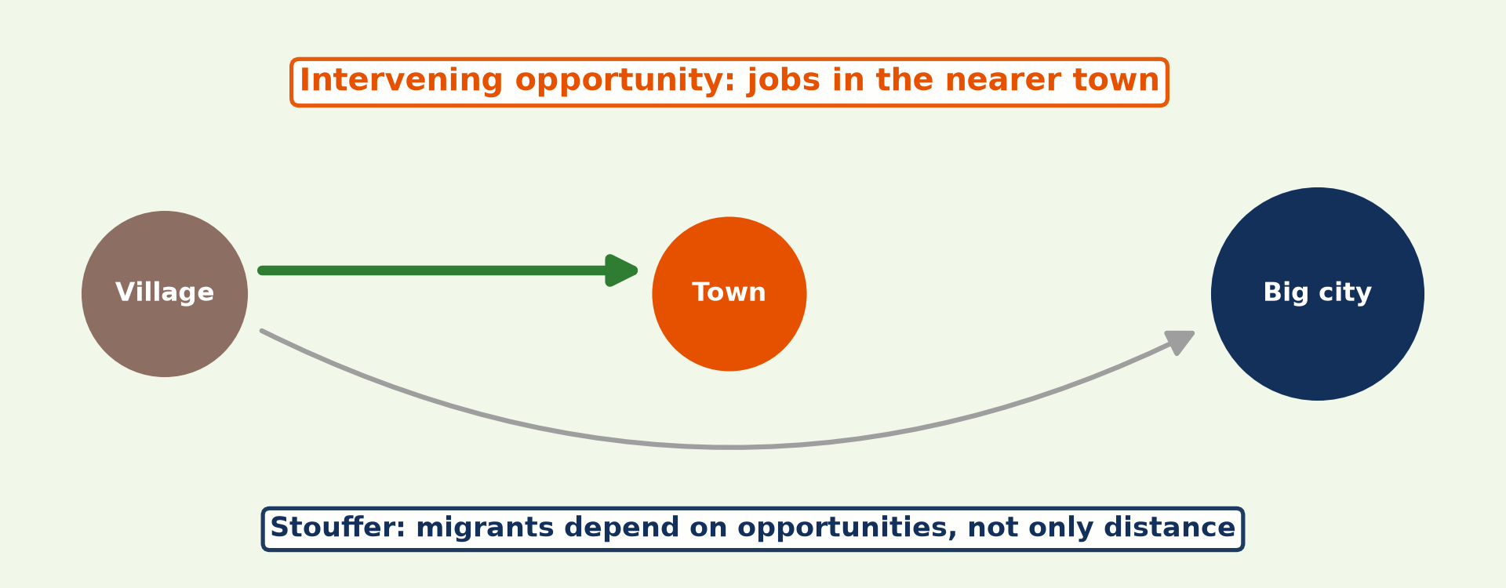
3. INTERVENING OPPORTUNITY
Activity 4
A nearer opportunity.
Notes:
Activity 4. Look carefully at this diagram: a nearer opportunity. Observe every detail before I ask the question.

Slide 31
3. INTERVENING OPPORTUNITY
Activity 4: Question
How can a new university in Ngaoundéré change the flow of students to Yaoundé?
Notes:
Here is the question for Activity 4: How can a new university in Ngaoundéré change the flow of students to Yaoundé? Take one minute to think and write your answer in your rough notebook.

Slide 32
3. INTERVENING OPPORTUNITY
Activity 4: Answer
It reduces it, because it is a nearer intervening opportunity.
Notes:
Let us check the answer together. It reduces it, because it is a nearer intervening opportunity.

Slide 33
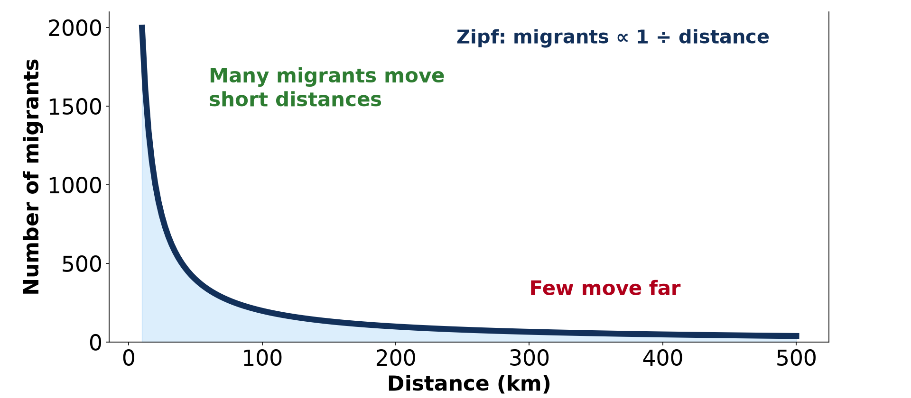
3. DISTANCE DECAY
Activity 5
Interaction and distance.
Notes:
Activity 5. Look carefully at this diagram: interaction and distance. Observe every detail before I ask the question.

Slide 34
3. DISTANCE DECAY
Activity 5: Question
Why do you visit a friend in your quarter more often than one in Kribi?
Notes:
Here is the question for Activity 5: Why do you visit a friend in your quarter more often than one in Kribi? Take one minute to think and write your answer in your rough notebook.

Slide 35
3. DISTANCE DECAY
Activity 5: Answer
Distance increases time, effort and cost.
Notes:
Let us check the answer together. Distance increases time, effort and cost.

Slide 36
BOARD SUMMARY
Board Summary
Topic: Population Change over Space (Migration)
Sub-topic: Migration Laws
Lesson 14: Spatial Interaction
Notes:
Now we are going to copy the board summary. Write the title and the headings neatly in your notebooks. I will give you enough time for each slide, so do not rush.

Slide 37
BOARD SUMMARY
DEFINITIONS
The key terms of this lesson are defined as follows:
Spatial interaction: It is the movement of people, goods, services and information between places.
Notes:
Let us copy the definitions. The key terms of this lesson are defined as follows. On this slide we have Spatial interaction. Write each point on a new line, with the key term first, and explain it in your own words when we revise. When you finish, we go to the next slide.

Slide 38
BOARD SUMMARY
DEFINITIONS (continued)
Complementarity: It is the situation where one place has a surplus of what another place needs.
Transferability: It is the ease and cost of moving goods or people between two places.
Distance decay: It is the decrease of interaction as distance increases.
Notes:
We continue with the definitions. On this slide we have Complementarity, Transferability and Distance decay. Write each point on a new line, with the key term first, and explain it in your own words when we revise.

Slide 39
BOARD SUMMARY
1. Meaning of Spatial Interaction
Spatial interaction is explained as follows:
Tangible flows: They are movements of people and goods that can be seen and counted. For example, lorries carry cotton from Garoua to the port of Douala.
Illustration: a lorry
Notes:
Let us copy Meaning of Spatial Interaction. Spatial interaction is explained as follows. Copy the point on Tangible flows on the left, then draw the diagram on the right: a lorry. Give it a title and label it clearly.

Slide 40
BOARD SUMMARY
1. Meaning of Spatial Interaction
Intangible flows: They are movements of information, money and services. For example, people make phone calls and send mobile money between Garoua and Douala.
Illustration: mobile money
Notes:
Copy the point on Intangible flows on the left, then draw the diagram on the right: mobile money. Give it a title and label it clearly.

Slide 41
BOARD SUMMARY
1. Meaning of Spatial Interaction
Networks: Flows use networks such as roads, railways, telephone lines, television and the internet. The denser the network, the stronger the interaction between places.
Notes:
We continue with Meaning of Spatial Interaction. Copy the point on Networks: write the key term first, then its explanation.

Slide 42
BOARD SUMMARY
1. Meaning of Spatial Interaction
Measurement: The volume of interaction between two places can be estimated with the gravity formula: I = Pi × Pj ÷ d². Large towns close to each other interact the most.
Notes:
We continue with Meaning of Spatial Interaction. Copy the point on Measurement: write the key term first, then its explanation.

Slide 43
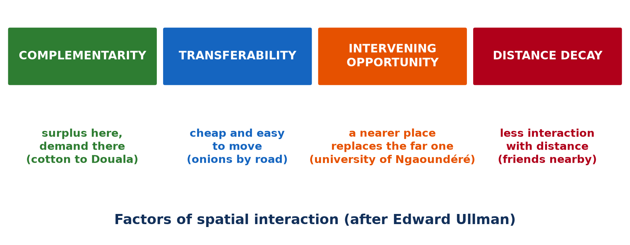
BOARD SUMMARY
2. Factors of Spatial Interaction
According to Edward Ullman, spatial interaction depends on the following factors:
Complementarity: Interaction occurs when one area has a surplus of something that another area needs. For example, the cotton of the North supplies the textile factories of the South.
Illustration: Ullman's factors
Notes:
Let us copy Factors of Spatial Interaction. According to Edward Ullman, spatial interaction depends on the following factors. Copy the point on Complementarity on the left, then draw the diagram on the right: ullman's factors. Give it a title and label it clearly.

Slide 44
BOARD SUMMARY
2. Factors of Spatial Interaction
Transferability: Goods and people must be cheap and easy to move between the two places. Good roads allow onions to go from Garoua to Maroua by lorry, while a bad road reduces the trade.
Illustration: the cotton harvest
Notes:
Copy the point on Transferability on the left, then draw the diagram on the right: the cotton harvest. Give it a title and label it clearly.

Slide 45
BOARD SUMMARY
2. Factors of Spatial Interaction
Intervening opportunity: A nearer or cheaper place can replace a distant one. For example, the university of Ngaoundéré or of Garoua keeps northern students from travelling to Yaoundé.
Notes:
We continue with Factors of Spatial Interaction. Copy the point on Intervening opportunity: write the key term first, then its explanation.

Slide 46
BOARD SUMMARY
2. Factors of Spatial Interaction
Distance decay: Interaction falls as distance rises, because travel costs more time and money. People therefore visit friends in their own quarter more often than friends in Kribi.
Illustration: distance decay
Notes:
Copy the point on Distance decay on the left, then draw the diagram on the right: distance decay. Give it a title and label it clearly.

Slide 47
FORMATIVE EVALUATION
Evaluation 1
Explain complementarity with an example.
Notes:
Now let us check what you have understood. Question 1: Explain complementarity with an example. Answer in your exercise book.

Slide 48
FORMATIVE EVALUATION
Expected Answer
One place has a surplus that another needs, e.g. cotton from the North sent to textile factories in Douala.
Notes:
The expected answer is: one place has a surplus that another needs, e.g. cotton from the North sent to textile factories in Douala. If you got it right, well done.

Slide 49
FORMATIVE EVALUATION
Evaluation 2
What is distance decay?
Notes:
Now let us check what you have understood. Question 2: What is distance decay? Answer in your exercise book.

Slide 50
FORMATIVE EVALUATION
Expected Answer
The decrease of interaction between places as distance increases.
Notes:
The expected answer is: the decrease of interaction between places as distance increases. If you got it right, well done.

Slide 51
REMEDIATION
Remediation
Fill in the blanks:
The movement of goods, people and information is spatial ______.
The ease of moving goods is called ______.
Interaction falls with distance: distance ______.
Notes:
For those who need more practice, fill in the blanks in your exercise book. The answers are: number 1, interaction; number 2, transferability; number 3, decay.

Slide 52
HOMEWORK
Homework
Define an internally displaced person.
Notes:
For your homework: Define an internally displaced person. We shall correct it at the beginning of our next lesson.

Slide 53
NEXT LESSON
Next Lesson
Our next lesson will be on:
Lesson 15: Types of Migration
Notes:
Our next lesson will be on Lesson 15: Types of Migration. Thank you for your attention, and see you next time.

Slide 54
BILINGUAL GAME
Bilingual Game (Jeu Bilingue)
English | Français
Spatial interaction | L'interaction spatiale
Complementarity | La complémentarité
Transferability | La transférabilité
Distance decay | L'atténuation par la distance
Goods | Les marchandises
Network | Le réseau
Notes:
Let us play the bilingual game. I say a word in English, and you give me the French word. Then we do the reverse.

Slide 55
LOGBOOK
Official Logbook (1/2)
Module / Topic | Population Change over Space (Migration)
Lesson Title | Lesson 14: Spatial Interaction
Expected Learning Outcomes | Define spatial interaction. Distinguish tangible and intangible flows. Explain complementarity and transferability. Explain intervening opportunity and distance decay.
Competence | Learners are able to explain the flows of people, goods and information between places using the factors of spatial interaction.
Notes:
I record this information in the official logbook of the class after the lesson.

Slide 56
LOGBOOK
Official Logbook (2/2)
Matter Taught | DEFINITIONS; Meaning of Spatial Interaction; Factors of Spatial Interaction.
Evaluation | Formative evaluation and remediation exercise.
Homework | Define an internally displaced person.
Enrolment / Present / Absent | ____ / ____ / ____
Achievement | To be completed after the lesson.
Notes:
I complete the second page of the logbook: the matter taught, the evaluation, the homework and the attendance.

Slide 57
TEACHER'S NOTE
Teacher's Note
Timing: Homework correction, plan, objectives 8 min | Recall, situation, action 10 min | 5 activities 30 min | Board summary (copying) 30 min | Evaluation, remediation 10 min | Homework, next lesson 5 min | Logbook 7 min
Without the projector (Activity 1): list flows between Garoua and Douala.
Without the projector (Activity 2): draw an arrow from Garoua to Douala.
Without the projector (Activity 3): compare transport costs.
Without the projector (Activity 4): draw the route Garoua–Ngaoundéré–Yaoundé.
Without the projector (Activity 5): ask learners where their friends live.
Notes:
This slide is for me, the teacher: it gives the timing of the lesson and what to do if the projector is not available.

Slide 58
REFERENCES
References
Geography Syllabus for Sixth Forms (Lower and Upper Sixth), MINESEC, 2019 — Module 4 (Population Geography).
Teacher's course notes: Mr KAMDEM E., Population Geography (USA), GBHS Garoua, 2026.
United Nations, World Population Prospects 2024.
Photo, Activity 1: “Scenes from Rwanda” by International Monetary Fund, CC BY-NC-ND 2.0, via Flickr (https://www.flickr.com/photos/38851430@N07/52660758172)
Photo, Activity 2: “Cotton harvest” by CIFOR, CC BY-NC-ND 2.0, via Flickr (https://www.flickr.com/photos/45423546@N07/35706862552)
Photo, Activity 3: “Traveling by truck” by World Bank Photo Collection, CC BY-NC-ND 2.0, via Flickr (https://www.flickr.com/photos/10816734@N03/2628517227)
Diagrams and animations: drawn for this lesson (Geography Department).
Notes:
These are the references and picture credits used to prepare this lesson.

